Slide 1
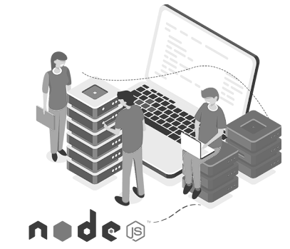

BACK-END DEVELOPMENT
WEEK 2 – Native HTTP Server & Manual Routing

Slide 2
After Finishing This Lecture:
Create a basic HTTP server using Node.js
Manually route HTTP requests using method + URL
Extract query parameters and request body
Understand how request and response objects work

Slide 3

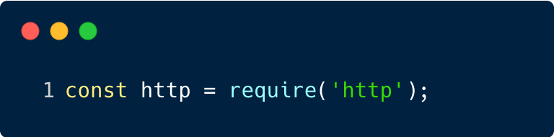
What is http in node.js
Built-in module to create web servers.
Provides tools to handle requests, responses, and network events.
No need to install it. It's part of Node.js core.

Slide 4
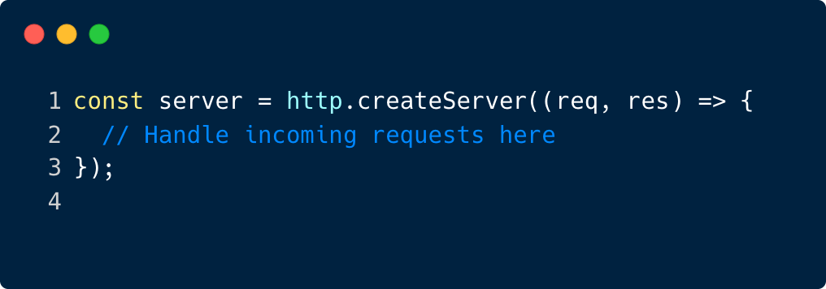
What's Inside the http Module?
http.createServer(): Creates a server instance.
req (IncomingMessage): represents the client request.
res (ServerResponse): represents the server response.

Slide 5
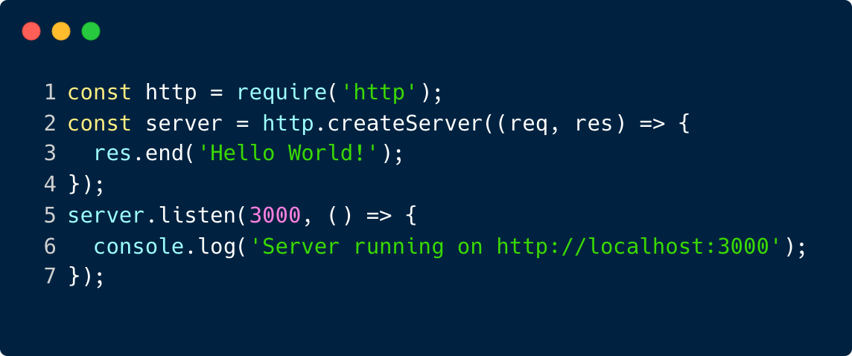
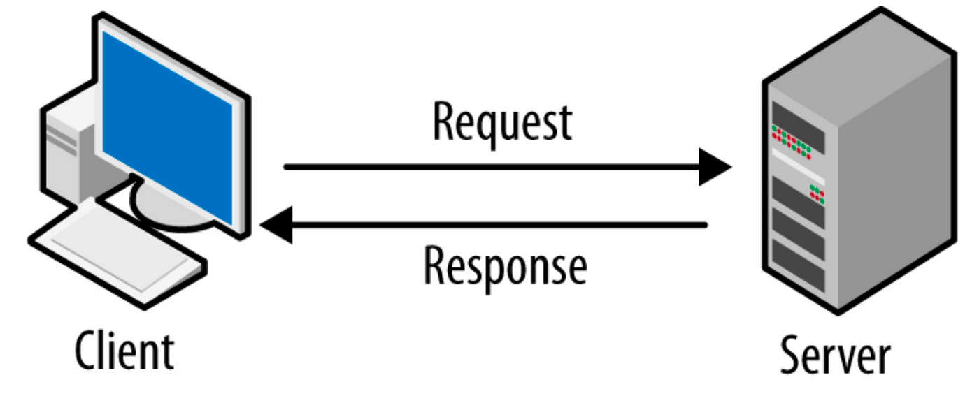
Creating an HTTP Server
Activity
What happens if we don't call res.end()?
Why is the callback in listen() useful?

Slide 6
What is res.end()?
res.end() is a method on the Server Response object that ends the response process.
It tells the server, "I'm done sending data to the client."

Slide 7
Real-World Analogy
Think of req as a letter someone mails to you, with:
Their name, message (body), metadata (headers), and return address.
res is your reply letter, where:
You choose what to send back, what tone (status code), and how it’s packaged (headers).

Slide 8
Manual Routing
Routing means deciding what code to run based on:
HTTP Method: GET, POST, PUT, DELETE, etc.
URL Path: /, /about, /api/user, etc.

Slide 9
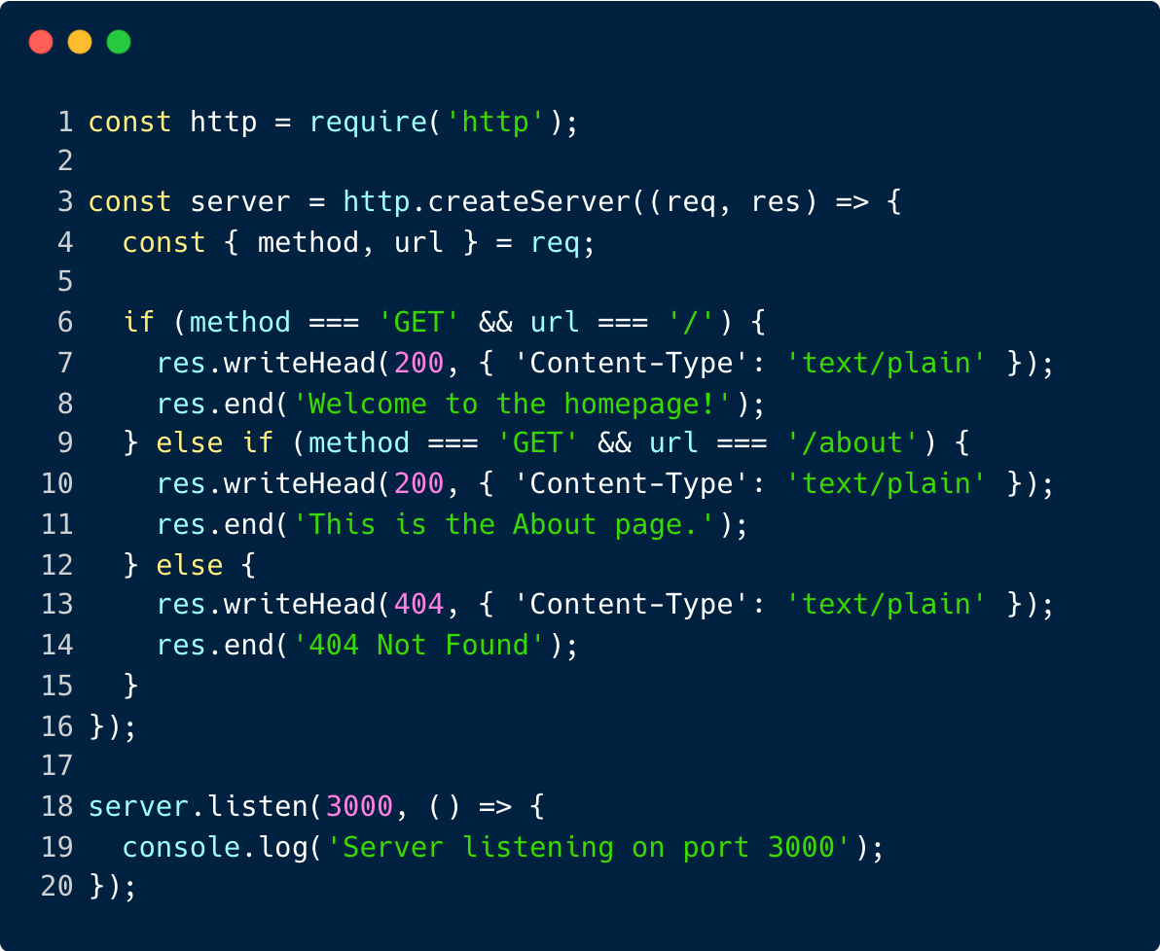
Manual Routing
req.method: checks the HTTP method (GET, POST, etc.)
req.url: checks the requested path (/, /about, etc.)
You use basic if/else or switch to match routes.

Slide 10
mini challenge
✏️ Add a new route: GET /contact that responds with “Contact us at support@example.com.”

Slide 11
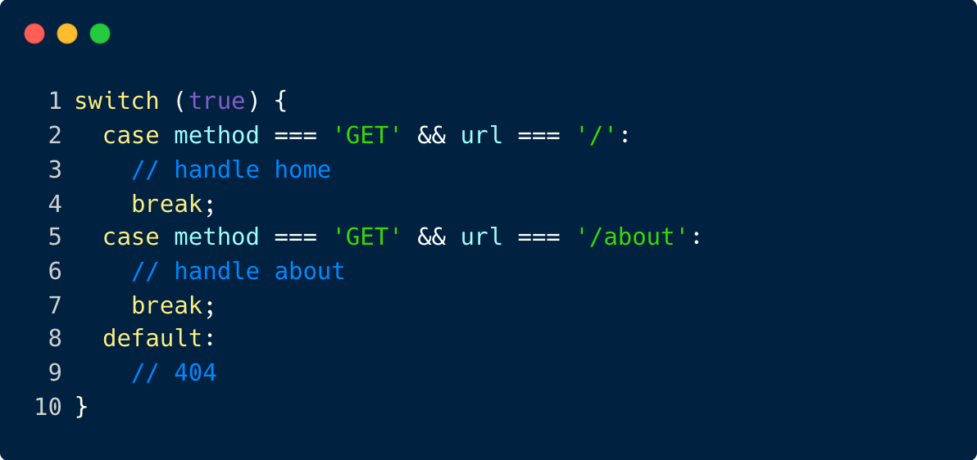
Bonus: Use switch for Cleaner Routing

Slide 12
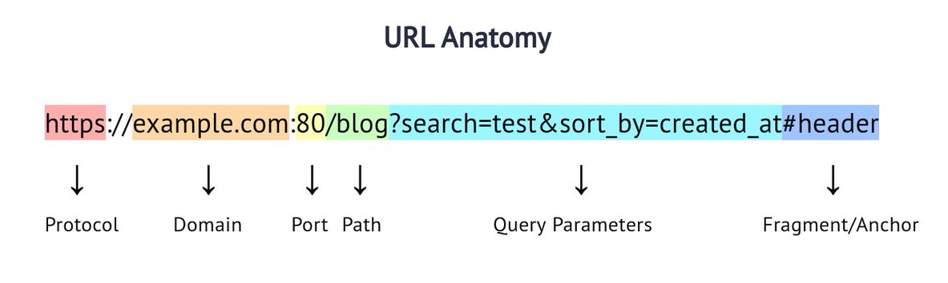
Web Components
Uniform Resource Locator (URL)

Slide 13
How can we handle that URL in node’s http module?
curl "http://localhost:8080/blog?search=sdfsdf&sort_by=sdfsd"
Method = GET
Path = /blog
Query:
- search=test
- sort_by=created_at

Slide 14
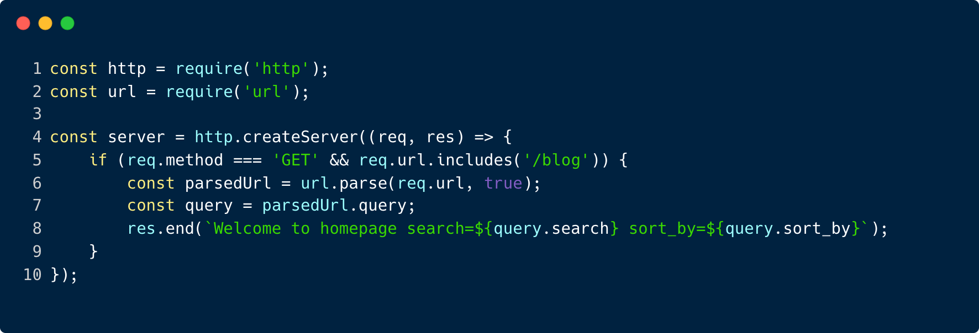
How can we handle that URL in node’s http module?
Method = GET
Path = /blog
Query:
- search=test
- sort_by=created_at

Slide 15
Property | Description
req.method | HTTP method like GET, POST, etc.
req.url | The requested path (can include query string)
req.headers | Object of key-value headers
req.body | 🚫 Does NOT exist by default! You must read it manually using streams
Request and Response Objects
Key Properties of req (Request)

Slide 16
Property/Method | Description
res.writeHead() | Sets status code and headers
res.write() | Sends chunks of data
res.end() | Finalizes and sends the response
res.setHeader() | Sets headers individually
Request and Response Objects
Key Methods/Properties of res (Response)

Slide 17
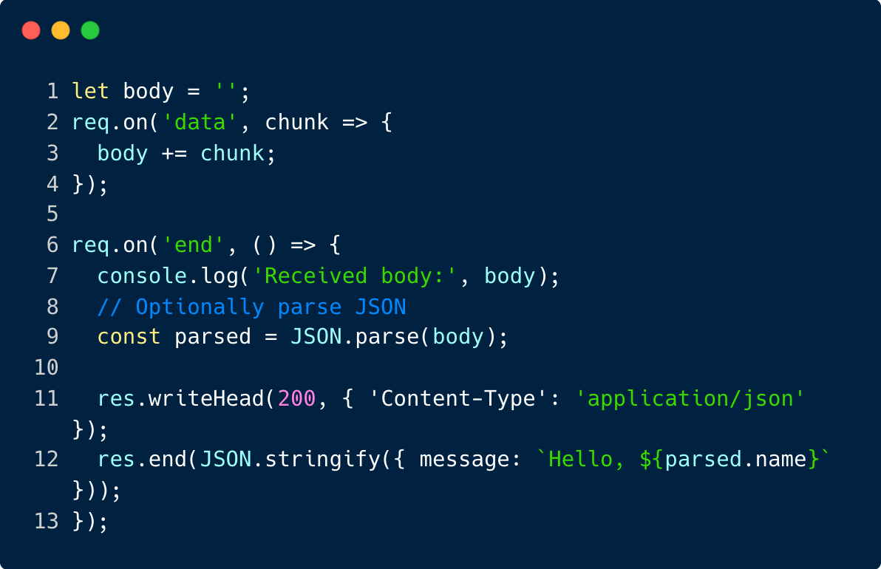
Reading the Body (e.g., POST request)
Why Is the Body a Stream?
req is a readable stream, and the body arrives in chunks (especially for large payloads).
You must collect chunks and then process the whole body when the stream ends.

Slide 18
How to POST request with body using CURL
curl -X POST https://example.com/api \
-H "Content-Type: application/json" \
-d '{"key1":"value1", "key2":"value2"}'
-X POST: explicitly sets the HTTP method (optional if using -d)
-H "Content-Type: application/json": tells the server you're sending JSON
-d: sends the request body

Slide 19
Get Your Hand Dirty
What happens if you send malformed JSON?
What if you send data in URL-encoded format instead?

Slide 20

WHAT WE HAVE LEARNT
Create a basic HTTP server using Node.js
Manually route HTTP requests using method + URL
Extract query parameters and request body
Understand how request and response objects work

